Slide 1
Modernization to Snowflake
February 2026
Version 1.0

Slide 2
Cloud Modernization Patterns
Most common approaches to Cloud Modernization. Replatform and modernize has proven to be the most pragmatic approach with the maximum value to clients while lowering the total cost of ownership with minimal risk to delivery.
Comparative Study of the approaches
1
REPLATFORM & REENGINEER
Most Pragmatic Approach
Two phased approach. First, replatform existing code base from Source Data platform to cloud. Selective processes are refactored to improve performance, solution stability and maintainability. Second, modernize to target state (e.g. Data Products, Data Mesh, etc.)
High
1
USE CASES/BUSINESS PROCESSES
2
2
Modernization/implementation of prioritized use cases and/or business processes. Fastest time to market and value for the selected use cases/business processes. Introduces high degree of complexity due to data bridging required and very high level of business disruption.
Probability of Success
3
4
3
REARCHITECT & REENGINEER
Design and implement existing and net new capabilities on to a cloud to take full advantage of cloud native and/or cloud enabled features. Data models and processes are re-architected and re-engineered to replace the existing solution and add new functional capabilities. Very high complexity and business disruption and lowest technical debt.
Value*
High
REPLATFORM
*Value represents:
Faster time-to-market for new capability launches
Efficient system with reduced technical debt
Lower total cost of ownership
Business Disruption
Total time for modernization
4
Lift and shift of existing code base from Source Data platform to cloud (or Hybrid architecture) with minimal refactoring to maintain the status quo of existing applications. Lowest business disruption and fastest time to market to decommission legacy platform. Highest technical debt. Not recommended as a standalone option.
Cost Savings –Reduction in Future Operational Expenditure Size of the bubble represents the degree of cost savings

Slide 3
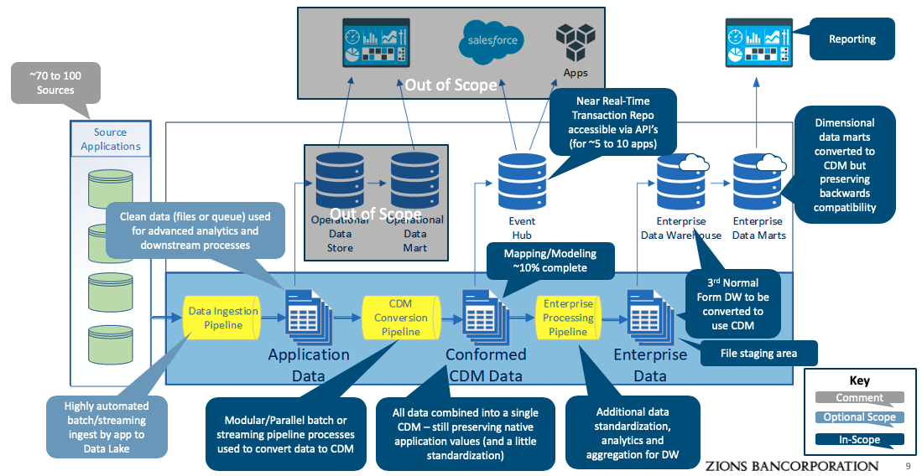
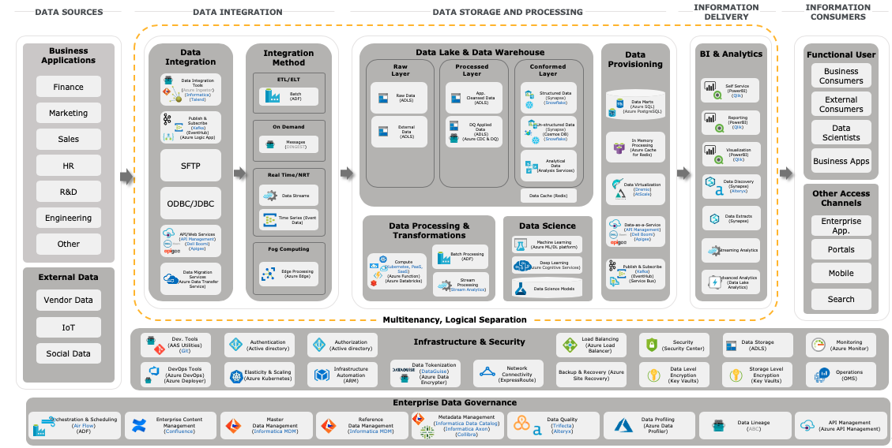
FDE Practice Modernization Factory – Our Differentiated Approach
We bring market leading automation across each of the implementation phases to successfully deliver client engagements
ENTERPRISE DATA ANALYTICS AND MODERNIZATION AUTOMATION LED APPROACH
1a
Modernization Design & Plan
1b
Implement: Minimum Viable Product (“MVP”)
2
Scale-out: Re-platform and Refactor
3
Testing, Data Ops, Optimize
Establish Foundation
Continuous Delivery of Enterprise and Domain Applications
Retire Legacy Applications
Upon successful completion of testing cycles and transition to operate team for all associated use cases by domain, it will be live in production
Incorporate dependencies and co-relationships between Enterprise and Domains Assets
Modernization PODs
Integration Management
Across Enterprise
Prioritize Use Cases, Enterprise and Domain Assets and Source Systems
Enterprise PODs
Domain PODs
Other PODs
Modernization assessment, Roadmap and plan, Validate use case and data domain tranches
Adoption of Future Target State Platform
Pool of SMEs
(Network, Security, Database, Platforms, Tools, Domain etc.)
Technology blueprinting
AWS / Snowflake Center of Excellence
(Automation frameworks, Azure / Snowflake build strategies)
Agile Delivery
Dev Ops
Execution Model (Delivery PODs)
Enable new capabilities
Optimize
Technical: Collect system characteristics and behavior. Identify optimization areas for performance and cost
User: Collect feedback from users, and triangulate with system documentations of reported issues and perform optimizations
Technology tooling options
Upstream & downstream capabilities
Foundation Services (Refactor / Rehost)
Conformed Data Model
Integration Patterns
Automation Frameworks
Current State Architecture
Automation framework
Future State Architecture
Audit, Balance & Control Framework
Data Mgmt. & Security
MVP Use Case implementation
Updated Modernization Roadmap and Refined Future State Architecture
Data Certification & Lifecycle Management
Governance & Security
Data Security
Program Management & Governance
Establish the key functions required to govern program strategy and execution, manage staffing needs, monitor delivery progress and quality, and provide change management support
Iteratively migrate use cases / data domains to production for live workloads and begin sunset approach of legacy applications

Slide 4
FDE Practice and Snowflake – Our Automation Suite
Our Automation led approach mitigates risk and accelerates delivery, which leads to significant cost reduction and faster realization of benefits while minimizing the risk of human error, business disruption and impact of change
CAPABILITY
0
REDUCTION
100
AI AGENT/AUTOMATION
Code Migration Analysis
Up to 90%
ETL code Reverse Engineering
10
DDL, View and SQL Code Conversion
Up to 60%
DB Code Converter
40
ETL Code Conversion
Up to 50%
ETL Code Converter
50
Accelerators Orchestration
Up to 50%
Data Assist Orchestration Agent
50
History Data Migration
Up to 50%
FDE Practice Historical Data Migrator
50
Data Reconciliation, Validation & Testing
Up to 40%
ETL Code Tester (CATE)
60
Report Reconciliation, Validation & Testing
Up to 40%
Automated Report Texter (X-Ray)
60
Effort with automation
Normal effort
Notes:
Rupesh

Slide 5





Global Industrial Products Company
Finance Data Hub 1.0 Migration to Snowflake
Engagement Summary
Setup the foundation on Snowflake and hardened the platform architecture
Ingested data from 4 ERPs (SAP ECC, SAP S/4, Oracle ERPs)
Migrated Synapse based Finance Data Hub 1.0 to Snowflake
Repointed Power BI reports to Snowflake
Approach and Solution
Migrated 3 environments, 1,000+ tables and 600+ data pipelines from Synapse to Snowflake
Converted all ETL scripts & stored procedures to Snowflake compatible formats and execute load on Snowflake using SnowConvert
Migrated all historical data from Synapse to Snowflake
Updated existing Synapse-sourced reports and dashboards in Power BI to read directly from Snowflake
Updated outbound feeds and applications based on Sypanse to Snowflake
Value Delivered
Setup the foundation for Finance Transformation (FDH 2.0)
Reduced TCO on Snowflake platform
Improved data availability and SLAs
Optimized performance and user experience
Simplified code implementation improving supportability
Migration to Snowflake without any impact to business users
3 Environments
1,000+ Tables
600+ ETL mappings
400+ ADF Pipelines
125+ Power BI reports
150 TB
Core Capabilities
Enabled Data Mesh base architecture
Centralized reporting from cloud-based solution
Automation where possible to minimize conversion risk and limit manual coding and validation activities
Increase data versatility by creating a scalable, reusable Cloud based infrastructure
Facilitate data access by updating ingestion and storage processes
Improve time to market and reduce development effort by enhancing existing frameworks and creating new framework
TECHNOLOGY STACK

Slide 6





Large Insurance Company
Enterprise Data Warehouse Modernization
Engagement Summary
Client identified need to migrate from Teradata to Snowflake due to a number of key challenges
Reduce Total Cost of Ownership by discarding annual Teradata costs
Approaching maximum storage capacity and did not wish to upgrade Teradata storage due to cost
Limited deep-knowledge on legacy codebase requiring in-depth assessment & documentation of current-state ecosystem at large
Approach and Solution
Migrated 8 environments, 800+ databases, & 17,000+ tables from Teradata to Snowflake
Converted all ETL scripts & mappings to Snowflake compatible formats and execute load on Snowflake
Migrated all historical data from Teradata to Snowflake
Updated existing Teradata-sourced reports and dashboards in MicroStrategy, Power BI, SAS, & Tableau to read directly from Snowflake
Updated outbound feeds and applications based on Teradata to Snowflake
Value Delivered
Heavy use of proven, thoroughly tested automation to reduce risk of manual error and accelerate pace and reduce cost and complexity
Rapid Modernization of data to target environment through a single “lift and shift” reduces user dislocation / confusion
Commitment of proven partners to deliver at leading pace reduces commercial and delivery uncertainty
Program design positions GRM to realize $25M+ in savings over current environment sooner and with more certainty
8 Environments
800+ Databases
17,000+ Tables
10,000+ ETL mappings
2,000+ SAS scripts
150,000+ BI reports
150 TB
Core Capabilities
Centralized reporting from cloud-based solution
Automation where possible to minimize conversion risk and limit manual coding and validation activities
Increase data versatility by creating a scalable, reusable Cloud based infrastructure
Facilitate data access by updating ingestion and storage processes
Improve time to market and reduce development effort by enhancing existing frameworks and creating new framework
TECHNOLOGY STACK

Slide 7
FDE Practice is positioned to lead AI and Data engagements with Snowflake
Our clear approach, depth, and close partnership make us well-positioned to win together
Why FDE Practice
Our Experience
Our Partnership
Unmatched depth in delivery services and personnel with domain expertise in data & AI technologies
ELITE
Services Partner, fastest to achieve top recognition by Snowflake Partner Network
FDE Practice named Snowflake’s Global Services Integrator Partner of the Year in 2021, 2022, and 2023 and Public Sector Partner of the Year in 2026
Leading in SAP, Oracle, SFDC, and Workday services, giving us end-to-end access to systems driving new data
550+
Global engagements to-date leading data modernization work leveraging Snowflake
Works with 90% of the Fortune 500 and been a C-suite business transformation leader for the past 175 years
10M+
Hours of direct consulting services related to Snowflake
Our Approach
Our Talent
Snowflake at FDE Practice
Migration Factory 2.0: Proven automation, at every phase, that reduces migration costs while minimizing risks and disruption to the operations.
1,100+
My Rate Finder: aggregating publicly available data from machine-readable files and enabling benchmarking analyses via interactive dashboards.
ConvergeConsumer: helps businesses make data-driven decisions with a suite of curated data sets, industry software solutions, & behavior insights tools.
Banking Data-as-a-Service: reconfiguring the banking value chain, opening the door to disintermediation and enabling new sources of growth
Certified Practitioners
POC Factory: provide unique deal constructs to find and deploy specific POCs and use cases to drive consumption
1,800+
Trained Practitioners
Snowflake GenAI POC Framework
GenAI Labs: immersive program will help businesses conceptualize and demystify Generative AI
16,000+
Frontend with Chatbot integration with Streamlit
LLM Interfacing with Snowflake Cortex
Containerized Application through Snowpark Container Services
Vector DB Store
critical for RAG-based solutions
Proven end-to-end migration at the desired scale and speed
Consulting professionals aligned to Cloud Hyperscalers in the U.S. marketplace

Slide 8
Data & Analytics Modernization Assessment
We conduct a modernization assessment to confirm the scope, prioritization, modernization approach, architecture, roadmap and business case. This can be customized to meet your needs.
Thread | Activity | Small | Medium | Large
Assessment | Conduct Migration Assessment to understand scope, dependencies and complexity | ✓ | ✓ | ✓
 | Database/Data Platform Migration Assessment | ✓ | ✓ | ✓
 | Data Management Capabilities (ETL, BI, orchestration, 3GL, etc.) Migration Assessment | ✓ | ✓ | ✓
 | Align on migration scope and priorities | ✓ | ✓ | ✓
 | Conduct workshop(s) to identify up to two new use cases |  | ✓ | ✓
Architecture | Conduct current state architecture assessment |  |  | ✓
 | Develop future state architecture blueprint |  |  | ✓
 | Confirm technology platform preferences and decisions | ✓ | ✓ | ✓
 | Finalize technology bill of materials | ✓ | ✓ | ✓
 | Develop target state architecture |  | ✓ | ✓
Roadmap | Identify migration options |  | ✓ | ✓
 | High-level cost analysis for migration | ✓ | ✓ | ✓
 | Confirm migration approach |  | ✓ | ✓
 | Develop migration roadmap and timeline | ✓ | ✓ | ✓
 | Develop staffing plan | ✓ | ✓ | ✓
Business case | Co-ordinate with Apple BU teams to connect inputs required for business case |  | ✓ | ✓
 | Develop Snowflake migration business case |  | ✓ | ✓
MVP | Define scope for MVP |  | ✓ | ✓
 | Execute MVP |  | ✓ | ✓
Duration |  | 4 weeks | 10 Weeks | 13 Weeks
Notes:
Rupesh

Slide 9
Our Value Proposition
Our Modernization factory approach has been designed to accelerate and de-risk the delivery of client outcomes
Delivery Certainty & Quality
Pricing Assurance
Proven, ‘Skin in The Game’ Partnership
Our approach reinforces confidence in the delivery of outcomes:
Extensive understanding of our client’s business needs, data & technology landscape
Proven automations successfully implemented at many prior cloud Modernization projects
Comprehensive testing strategy to ensure quality and error-free deployment
Robust planning allows us to reduce commercial uncertainty:
‘Conversion-as-a-Service’ using a ‘Modernization automation factory’ to deliver high velocity and quality results
Fixed fee program ensuring “no surprise“ philosophy
Accelerated timeline with committed dates
We bring proven partnerships with major cloud hyperscalers and commit to deliver on time, quality outcomes:
Joint implementation philosophy – unified methodology & approach with Cloud hyperscalers
Commercial constructs to incentivize on time, at quality delivery
Industry Leading Qualifications
We Are Leaders in Data & Analytics
Delivered Multiple Projects Using our Approach
We Bring the Most Comprehensive Expertise & Assets
Collaborative Style Proven Effective at many Clients

Slide 10
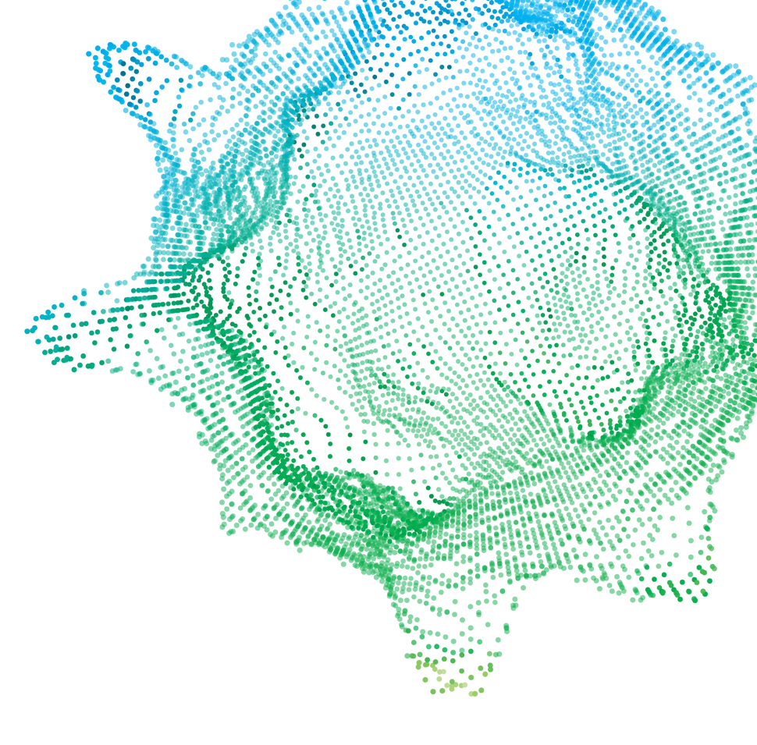
Thank you!
This publication contains general information only, and none of the member firms of FDE Practice Touche Tohmatsu Limited, its member firms, or their related entities (collective, the “FDE Practice Network”) is, by means of this publication, rendering professional advice or services. Before making any decision or taking any action that may affect your business, you should consult a qualified professional adviser. No entity in the FDE Practice Network shall be responsible for any loss whatsoever sustained by any person who relies on this publication.
As used in this document, “FDE Practice” means FDE Practice Consulting LLP, a subsidiary of FDE Practice LLP. Please see www.FDE Practice.com/us/about for a detailed description of the legal structure of FDE Practice USA LLP, FDE Practice LLP and their respective subsidiaries. Certain services may not be available to attest clients under the rules and regulations of public accounting.
Copyright © 2026 FDE Practice Development LLC. All rights reserved. Member of FDE Practice Touche Tohmatsu Limited

